Slide 1




Half&Half: Demystifying Intel’s Directional Branch Predictors
for Fast, Secure Partitioned Execution
Hosein Yavarzadeh Mohammadkazem Taram Shravan Narayan
Deian Stefan Dean Tullsen
Notes:
Thanks for the introduction!
Today I will be presenting the Half&Half, where we discovered a surprising hidden feature of Intel processors that can be used to significantly increase security, including shutting down an entire class of Spectre attacks with only about 4% of overhead.
This work is a team effort by UC San Diego, Purdue University, and UT Austin.

Slide 2

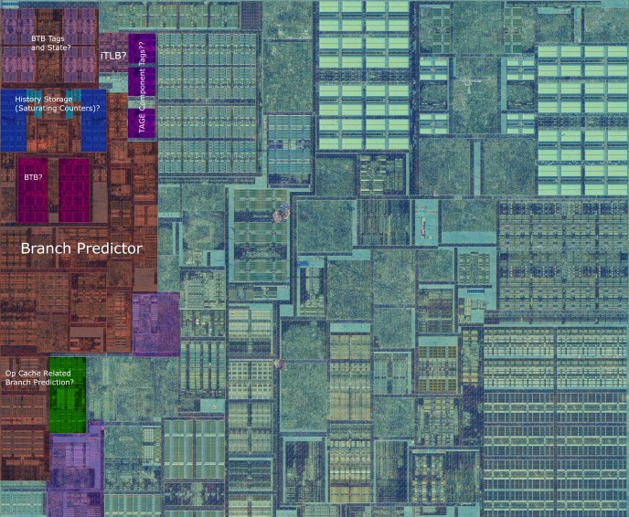
Branch Prediction
* Skylake’s die shot, Fritzchens Fritz
Notes:
We all know that branch prediction is super important for making modern high-performance processors run smoothly and keep the pipeline busy.

Slide 3
Branch Prediction
Taken or Not-Taken
je target
Where is the target?
Notes:
And the branch prediction unit accelerates performance by giving multiple predictions for each branch, like telling whether the branch will be taken or not taken, and even where it is going to lead the program.

Slide 4


Branch Prediction Unit
Predicting
Target Address
Branch Target Buffer (BTB)
Predicting
Direction
(Taken/Not-Taken)
Conditional Branch Predictor (CBP)
Undocumented &
Largely Unknown
Notes:
So, the branch prediction unit is designed with various structures to handle these different predictions.
For example, the Branch Target Buffer predicts the target while the Conditional Branch Predictor predicts the direction.
While researchers have extensively studied the structure of the BTB, the structure of the conditional branch predictor remains largely unknown.

Slide 5
Branch Prediction Unit
Read: get a prediction
je target
CBP
(Conditional Branch)
Write: resolve the branch
Notes:
We can think of the branch predictor as a structure that can be both read from and written to.
When a branch gets predicted, it's like performing a read operation and when the branch is resolved in the pipeline, it updates the branch predictor's state, like a write operation.

Slide 6



Branch Prediction Unit
Read: get a prediction
je target
CBP
Write: Resolve the branch
Mis-training attack: Spectre-PHT
Attacker
Write
Read
Victim
CBP
Notes:
In a mis-training attack like Spectre-PHT, the attacker manipulates the branch predictor's state, causing the victim to get mispredicted, enabling potential security breaches.

Slide 7




Branch Prediction Unit
Read: get a prediction
je target
CBP
Write: Resolve the branch
Mis-training attack: Spectre-PHT
Attacker
Write
Read
Victim
CBP
Leakage attack: Control Flow Extraction
Victim
Write
Read
Attacker
CBP
Notes:
In leakage attacks like control-flow extraction, the victim's writes to the branch predictor can be exploited by the attacker to extract sensitive information.

Slide 8



Shared between all processes, threads, and programs running within a physical core!
User space
Kernel
SMT thread 1
SMT thread 2
Sandboxed Code
Host program
Notes:
and since there is only one branch predictor per physical core, it is shared among all processes and threads running on that core and it creates a potential vulnerability, making it susceptible to side-channel attacks.
For instance, a malicious entity could exploit this vulnerability to breach the isolation between user space and kernel code or sandboxed code versus the host program, or even between two SMT threads.

Slide 9
1
Reverse Engineering Intel’s Conditional Branch Predictors (CBPs)
Ice Lake
Cascade Lake
Ivy Bridge
Haswell
Skylake
Tiger Lake
Alder Lake
2012
2013
2015
2019
2020
2021
Notes:
To tackle this problem, we reveal, for the first time, a comprehensive picture of the branch prediction unit for all of Intel’s flagship processors, going back more than a decade.
We’re disclosing key information like their size, structure, and exact indexing functions.

Slide 10
1
Reverse Engineering Intel’s Conditional Branch Predictors (CBPs)
2
Designing a software-only solution to branch predictor isolation
→ Only Minor Modifications in Existing Compilers
Notes:
Based on that, we propose Half&Half, a novel software-only solution for branch predictor isolation that requires no hardware or ISA changes.

Slide 11

Background: Conditional Branch Predictor (CBP)
The best predictor of future events is probably past events!
CBPs → history-based predictors
Branch Prediction
CBP
Notes:
Let me first cover a little bit background about the conditional branch predictors.
Branch predictors use the history of past events to predict future events.

Slide 12
Background: Conditional Branch Predictor (CBP)
→ history-based predictors!
Local history
if (rand(1,10) < 9)
Mostly Taken
Notes:
The first type of history is local history, where the prediction of a branch is based on its past occurrences.
For instance, if a branch is biased towards the Taken direction, the local predictor will predict it as Taken.

Slide 13
Background: Conditional Branch Predictor (CBP)
Local history
if (rand(1,10) < 9)
Mostly Taken
Notes:
A simple local predictor uses the branch address to index a table which stores the predictions.

Slide 14
Background: Conditional Branch Predictor (CBP)
→ history-based predictors!
Global history
if (x < 8)
…
if (x < 9)
Correlation
Notes:
On the other hand, there exists global history, which can capture correlations between different branches.
For example, consider two branches where the direction of the second branch is influenced by the outcome of the first branch.
If the first branch is true, the second branch is also predicted as true.

Slide 15
Background: Conditional Branch Predictor (CBP)
Global history
2nd Last Branch
History
3rd Last Branch
History
Last Branch
History
Branch Address
Global History:
 | …
Notes:
Global predictors typically use a combined index of branch address and global history for making predictions.

Slide 16
State-of-the-art: TAGE predictor (local + global)
Local
Near correlations
L₁ < L₂ < … < L_{n}
Far correlations
Local Predictor
Notes:
Presented here is a simplified version of the state-of-the-art conditional branch predictor known as TAGE.
TAGE employs a blend of a local and multiple global prediction tables, each utilizing an increasing length of global history.
For example, this design allows Table 1 to capture near correlations while Table n captures far correlations.

Slide 17
Reverse Engineering
Assumptions
TAGE-like multi-table predictor (local + global)
Notes:
We assume that intel’s branch predictor has a tage-like structure in the sense of using multiple tables

Slide 18
Reverse Engineering
Performance Monitoring Counters (PMCs)
Number of Branches
Number of Mispredicted Branches
Clock Cycles
Notes:
and we use performance monitoring counters to measure the results of our experiments.
like:
Number of Branches
Number of Mispredicted Branches
Clock Cycles

Slide 19
Target CPUs
Ice Lake
Cascade Lake
Ivy Bridge
Haswell
Skylake
Tiger Lake
Alder Lake
2012
2013
2015
2019
2020
2021
Notes:
Our targeted CPUs range from Ivy Bridge to recent microarchitectures like Alder Lake which is introduced just two years ago.
However, for the rest of this talk, I will present the results specifically for Skylake.

Slide 20
Reverse Engineering: Global History
for (i = 0; i < 2000; i++){
k = rand() % 2;
}
if (k) { /* … */ }
Notes:
I will now demonstrate a simple experiment that provides an intuitive understanding of how we discovered the global history details in Intel processors.
Consider an "if" statement within a for loop comprising 2000 iterations. The "if" statement branches based on a random bit (0 or 1).

Slide 21
Reverse Engineering: Global History
Results:
for (i = 0; i < 2000; i++){
k = rand() % 2;
}
Number of branches: 2000
Mispredicted branches: ~1000 → 50%
if (k) { /* … */ }
Miss-rate = 50%
Notes:
Out of 2000 occurrences of the "if" statement, the branch predictor mispredicts around 1000 times, indicating a 50% misprediction rate.
This is because the condition is based on a random bit, and the previous history is not helpful here.

Slide 22
Reverse Engineering: Global History
Results:
for (i = 0; i < 2000; i++){
k = rand() % 2;
}
Number of branches: 4000
Mispredicted branches: ~1000 → 25%
if (k) { /* … */ }
Miss-rate = 50%
if (k) { /* … */ }
Miss-rate = 0%
Notes:
Now assume two "if" statements with the same random condition.
Results show that the miss-rate for the first branch is again 50% and it is 0% for the second one which suggests that the branch predictor can predict the second branch based on the outcome of the first one.

Slide 23
Reverse Engineering: Global History
for (i = 0; i < 2000; i++){
k = rand() % 2;
}
if (k) { /* … */ }
Miss-rate = 50%
Dummy Branches (Taken)
if (k) { /* … */ }
Global history size → 93 Taken branches
Miss-rate = ?
Notes:
The global history has a limited size, and by increasing the distance between correlated "if" statements, we can determine this size.
By adding taken dummy branches between the correlated branches, we will eventually exhaust the global history and cause misprediction to the second branch.
[1] The results of this experiment show that the global history can only store information from last 93 taken branches.

Slide 24
Reverse Engineering: Global History
for (i = 0; i < 2000; i++){
k = rand() % 2;
}
if (k) { /* … */ }
Miss-rate = 50%
Dummy Branches (Not-Taken)
if (k) { /* … */ }
Miss-rate = ?
Global history → only Taken branches
Notes:
When not-taken dummy branches are inserted in between, the results are a bit surprising.
Regardless of the correlation distance, the predictor still accurately predicts the second branch.
This indicates that the global history is only updated based on taken branches.

Slide 25
Reverse Engineering: Global History
Global History Register (GHR)
→ Path History Register (PHR)
if (/* ... */)
target:
Branch Address
Taken
Target Address
Notes:
We discovered that Intel's branch predictors use a different mechanism for global history instead of the global history register (GHR) which stores the direction of branches.
It is called Path History Register (PHR) which is much less common form of global history.
The PHR obtains information from both the branch and target addresses for a taken branch, combines them, and inserts the resulting information into itself.

Slide 26
Reverse Engineering: Global History (PHR)
Branch Address [19:4]
Target Address [5:0]
B19
B4
T5
T0
Notes:
For example, In Skylake microarchitecture, we found that the PHR is updated using the 6 lower bits of the target address and bits 19 to 4 from the branch address.

Slide 27
Reverse Engineering: Global History (PHR)
B19
B4
T5
T0
B[19:4]
T[5:0]
16 bits
footprint →
PHR^{new} = (PHR^{old} << 2) ⊕ footprint
Notes:
We found that these bits are combined to form a 16-bit number called the branch footprint, which is then used to update the PHR.
When a branch is taken, the PHR shifts by two, and its lower 16 bits are XORed with this 16-bit footprint.

Slide 28
Reverse Engineering: Branch Address (PC)
PC [11:0]
PC [12:0]
Notes:
Additionally, we discovered that the 12 lower bits of the branch address were used as index and/or tag alongside the PHR in the global history tables.
Also, the 13 lower bits of the branch address were used as index in local predictor.

Slide 29
Reverse Engineering: Tables
4-way set associative
way 0
way 1
way 2
way 3
* See the paper for reverse engineering experiment details
Notes:
Based on our carefully crafted and complicated experiments, we discovered that each global predictor table employs a cache-like 4-way set associative structure.

Slide 30
Reverse Engineering: Tables
Direct-Mapped
Three Tables: Each 4-way
PHR [0:21]
PHR [0:57]
PHR [0:185]
Notes:
We identified not only one but also three global predictor tables alongside the local predictor, each of which is 4-way set associative.
Also, we found that each table uses a certain portion of the PHR.

Slide 31
Reverse Engineering: Index Hash Function
PHR bits:
8 bits
* See the paper for reverse engineering experiment details
Notes:
In the index hash function of global predictors, we found that PHR is run though a hash mechanism that reduces it to 8 bits.
For example, bit 21, 13, and 5 are XORed together to determine bit 0 of the index.
This folding process applies to other tables within the branch predictor as well.

Slide 32
Index Hash Function
21
13
 |  | k |  | … |  | k
Notes:
After reverse engineering the PHR, we can actually control every single bit of it using carefully crafted branches and we used this capability to find which of bits of the PHR has the same effect in making a prediction or in other words which bits are cancelling each other!

Slide 33
Reverse Engineering: Size
Each table consists of 512 sets → index size of 9 bits
9th Bit
Folded PHR: 8 bits
Notes:
Our experiments reveal that each table consists of 512 sets, indicating a need for a 9-bit index.
While 8 bits are derived from the folded PHR, the origin of the 9th bit remains a question.

Slide 34
Reverse Engineering: Index
PC [11:0] (Branch Address)
11 | 10 | 9 | 8 | 7 | 6 | 5 | 4 | 3 | 2 | 1 | 0
9th bit of index
Index = PC[5] + folded PHR
9 bits
1 bit
8 bits
Notes:
After doing meticulous experiments on all PC and PHR bits, we found a surprising secret thing that bit number 5 in branch address has been used as an index bit independently and this little secret feature can be used to easily partition the branch predictor to two partitions.

Slide 35
PC[5]: Partitioning the CBP
PC[5] = 0
PC[5] = 1
Notes:
For example, when PC[5] is 0, the branch predictor uses the first half of prediction tables, and when PC[5] is 1, it uses the second half.

Slide 36
Partitioning the CBP
Ice Lake
Cascade Lake
Ivy Bridge
Haswell
Skylake
Tiger Lake
Alder Lake
2012
2013
2015
2019
2020
2021
PC[4]
PC[5]
Notes:
In newer machines, bit [5] partitions the branch predictor, while older machines use bit [4].

Slide 37
Partitioned Branch Predictor
Prevent Attackers from Reducing Branch Accuracy
Eliminating Side Channels
Eliminating Poisoning attacks
Notes:
Partitioning the branch predictor helps prevent attackers from reducing branch accuracy and eliminates side channels and poisoning attacks.

Slide 38
Two Partitions: Is this sufficient?
User space
Kernel
SMT thread 1
SMT thread 2
Sandboxed Code
Host program
Notes:
Partitioning the branch predictor into two partitions is especially beneficial in scenarios involving two distrusting parties, such as user space/kernel, SMT threads, or sandboxed code versus the host program.

Slide 39
Implementation: Address Adjustment
PC[5] = 0
Original Code
Branch Address
Branch Address
Adding enough nops
nop
…
nop
0x1020
if (x < 8)
0x1100
if (x < 8)
PC[5] = 1
PC[5] = 0
* See the paper for optimizations
Notes:
We implement the partitioning mechanism by adjusting the addresses of all conditional branches by inserting enough number of “nop” instructions to get desired PC[5] value.
We have devised several optimizations to minimize the overhead of adding these nop instructions. For more information, please check out the paper.

Slide 40
Implementation
LLVM compiler
Swivel Compiler (WebAssembly compiler)
Notes:
We incorporating our address adjustment techniques into two compilers: LLVM compiler and Swivel compiler.
The Swivel compiler specifically targets WebAssembly to mitigate Spectre and memory safety attacks.

Slide 41
Security Evaluation
Running Spectre-PHT attack with and without Half&Half
The attack is not effective when Half&Half is deployed!
Notes:
In the security evaluation, we run Spectre-PHT proof-of-concept attack with and without Half&Half.
We found that the attack is not effective when Half&Half is deployed!

Slide 42
Security Evaluation
Stress Testing
Benign Code
Malicious Code
Function A
1024 branches
Function B
Variable # of branches
Notes:
In the other security evaluation, we have two functions: Function A, considered benign, and Function B, considered malicious.
The objective of this evaluation is to examine the impact of Function B on the behavior of Function A.
Function A consists of 1024 branches, while Function B has a variable number of branches.
These branches have varying correlation distances therefore they use all prediction tables.

Slide 43
Security Evaluation
Stress Testing
Baseline:
Actual Test:
loop {
}
loop {
}
Call Function A
Call Function A
Call Function B(N)
N: number of branches in Function B
Notes:
The baseline approach involves running and collecting the misprediction rate specific to Function A in isolation.
[1] The actual test involves running both functions and gradually increasing the number of branches in Function B to measure the corresponding misprediction rate of Function A.

Slide 44
Security Evaluation
Stress Testing
Actual Test:
loop {
}
Without Half&Half
Call Function A
Call Function B(N)
N: number of branches in Function B
Notes:
We see when there’s no partitioning the misprediction rate of Function A is heavily affected by the number of branches within Function B.

Slide 45
Security Evaluation
Stress Testing
Actual Test:
loop {
}
Call Function A
With Half&Half!
Call Function B(N)
N: number of branches in Function B
Notes:
However, when the partitioning is enabled, misprediction rate is flat and near zero!

Slide 46
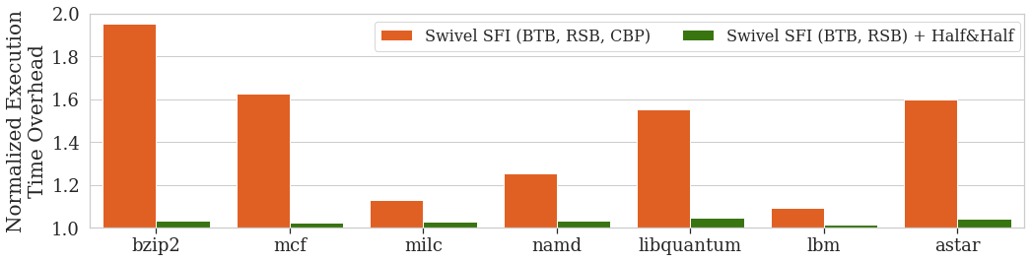
Performance Evaluation
Swivel compiler
Geometric Mean
Swivel SFI (BTB, RSB) + Half&Half | 4.05%
Swivel SFI (BTB, RSB, CBP) | 59.79%
SPEC 2006 Benchmark (C, C++)
Notes:
For the performance evaluation, we replaced Swivel SFI's CBP mitigation with Half&Half and observed a substantial reduction in overhead.
While Swivel SFI incurred an average execution time overhead of 59%, Half&Half resulted in only about 4% overhead.

Slide 47
Performance Evaluation
LLVM compiler
Geometric Mean
PC[4]: Old machines | 3.66%
PC[5]: New machines | 3.79%
Architecture Independent | 5.43%
SPEC 2006 Benchmark (C, C++)
Notes:
For the LLVM compiler, we have three configurations:
partitioning bit 4 for older processors.
partitioning bit 5 for new processors
partitioning both bits for architecture independent cases for backward compatibility.
In all scenarios, the geometric mean was less than 5.4%.

Slide 48
Performance Evaluation
Partitioning the CBP across SMT threads
Geometric Mean
Domain B | 2.55%
Domain A | 2.54%
SPEC 2006 Benchmark (C, C++)
Notes:
Half&Half can be used to partition the branch predictor between two SMT threads.
The average execution time overhead on both threads is less than 2.6%.

Slide 49
User / Kernel

Slide 50
Where is the overhead coming from?
Mis-rate | 2.8%
Instructions | 9%
Notes:
We measure an overall 2.8% increase in branch misses in partitioned mode and the average increase in dynamic instructions due to NOPs is 9%.
Since it run on a physical machine and not a simulator, we were not able to distinguish between newly created aliasing and eliminated ones, but it seems that both instructions size and misprediction rate have roughly equal contributions to the execution overhead of Half&Half.

Slide 51
Limitations
Spectre in-place training attack
attacker:
victim:
0x1234
if (TRUE) {
/* … */
}
0x1234
if (i < array_size) {
load(i);
}
Out-of-place training attack
victim:
0x1234
if (i < array_size) {
load(i);
}
in-place training attack

Slide 52
Partitioning into more than two partitions
PC [11:0] (Branch Address)
11 | 10 | 9 | 8 | 7 | 6 | 5 | 4 | 3 | 2 | 1 | 0
9th bit of index
Index = PC[5] + folded PHR
9 bits
1 bit
8 bits
Notes:
So first of all, since we know all the detail about indexing functions, we can, in theory, partition the CBP to more than two partitions. But in order to so that we have to control multiple PHR bits which means controlling the global history of the program and to do that we have to control branch and target addresses of many branches within the program which comes with a large overhead.
But again, Half&Half is able to solve the isolation problem when there’s only two distrusting parties like sandboxed code vs Host and so on,

Slide 53


Other vendors

Slide 54
Questions?
hyavarzadeh@ucsd.edu
Notes:
Thank you for joining this talk and I’ll be happy to take the questions!

